Slide 1
A Layout of Data and Check Bits that Achieves Our Design Criteria:
C1 is a parity check on every data bit whose position is xxx1
C1 = D1 exor D2 exor D4 exor D5 exor D7
C2 is a parity check on every data bit whose position is xx1x
C2 = D1 exor D3 exor D4 exor D6 exor D7
C4 is a parity check on every data bit whose position is x1xx
C4 = D2 exor D3 exor D4 exor D8
C8 is a parity check on every data bit whose position is 1xxx
C8 = D5 exor D6 exor D7 exor D8
Why this ordering? Because we want the syndrome, the Hamming test word, to yield the address of the error.

Slide 2
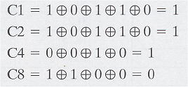
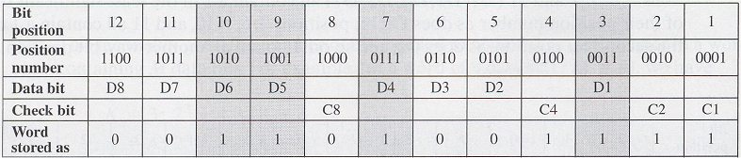
Example:
Data stored = 00111001
Check bits:
C1 = D1 exor D2 exor D4 exor D5 exor D7
C2 = D1 exor D3 exor D4 exor D6 exor D7
C4 = D2 exor D3 exor D4 exor D8
C8 = D5 exor D6 exor D7 exor D8
Putting it together:

Slide 3
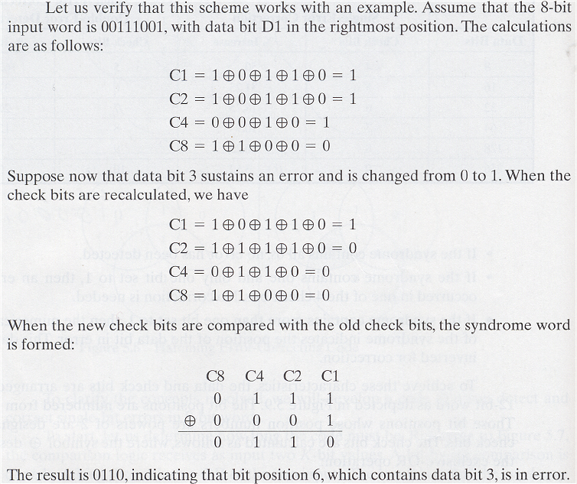
Example:
C1 = D1 exor D2 exor D4 exor D5 exor D7
C2 = D1 exor D3 exor D4 exor D6 exor D7
C4 = D2 exor D3 exor D4 exor D8
C8 = D5 exor D6 exor D7 exor D8

Slide 4
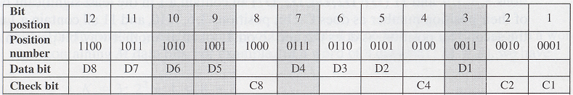
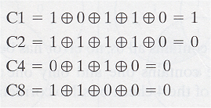
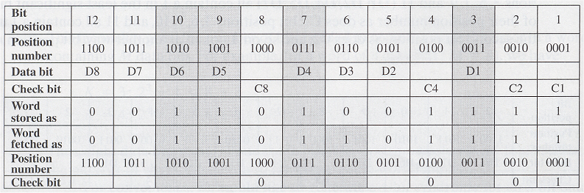
Example:
C1 = D1 exor D2 exor D4 exor D5 exor D7
C2 = D1 exor D3 exor D4 exor D6 exor D7
C4 = D2 exor D3 exor D4 exor D8
C8 = D5 exor D6 exor D7 exor D8
Word fetched:
Check Bits:
Comparing:
C8 C4 C2 C1
0 1 1 1 Orig Check Bits
0 0 0 1 New Check Bits
0 1 1 0 Syndrome
Putting it all together:
0110 = 6 ➔ bit position 6 is wrong, i.e. bit D3 is wrong

Slide 5
ERROR CORRECTION
Error correcting code is to include enough redundant information along with each block of data sent to enable the receiver to deduce what the transmitted character must have been.
Error Correction must be handled in two ways :
Retransmission-When an error is discovered, the receiver can have the sender retransmit the entire data unit.
FEC-Receiver can use an error correcting code, which automatically corrects certain errors.

Slide 6
There are two types of Error Correcting techniques :
1. Single bit error correction.
2. Burst error correction.
Error Correction can be done with the help
of HAMMING CODE.

Slide 7
HAMMING CODE
It is a technique developed by R.W.Hamming.
Hamming code can be applied to data units of any length and uses the relationship between data and redundancy bits. For eg.

Slide 8
A 7 bit ASCII code requires 4 Redundancy bits that can be added to the end of the data unit or interspersed with the original data bits.
These bits are placed in positions 1,2,4 and 8. We refer to these bits as r1,r2,r4 and r8.
Length of the bit=m+r : (7+4=11) m: no.of data bit
r: redundant bit
To calculate the no.of redundancy bits(r) required to correct a given number of data bits(m)
Formula: 2 ^{r} >=m+r+1

Slide 9
Positions of Redundancy Bits in Hamming Code
11
10
9
8
7
6
5
4
3
2
1
d | d | d | r | d | d | d | r | d | r | r
Redundancy Bits

Slide 10
In the Hamming code, each r bit is the VRC bit for one combination of data bits :
- r1 is the one combination of data bits.
- r2 is another combination of data bits.
and so on.
The combination used to calculate each of the four values for a 7 bit data sequence are as follows :
- r1 : bits 1,3,5,7,9,11.
- r2 : bits 2,3,6,7,10,11.
- r4 : bits 4,5,6,7.
- r8 : bits 8,9,10,11.

Slide 11
Data : 1 0 0 1 1 0 1
Data
1 | 0 | 0 |  | 1 | 1 | 0 |  | 1
Adding r1
1 | 0 | 0 |  | 1 | 1 | 0 |  | 1 |  | 0
Adding r2
1 | 0 | 0 |  | 1 | 1 | 0 |  | 1 | 0 | 1
r1 : bits 1,3,5,7,9,11.
r2 : bits 2,3,6,7,10,11.
r4 : bits 4,5,6,7.
r8 : bits 8,9,10,11.
Adding r4
1 | 0 | 0 |  | 1 | 1 | 0 | 0 | 1 | 0 | 1
Adding r8
1 | 0 | 0 | 0 | 1 | 1 | 0 | 0 | 1 | 0 | 1
11
10
9
8
7
6
5
4
3
2
1
Code : 1 0 0 1 1 1 0 0 1 0 1

Slide 12
Data : 1 0 0 1 1 0 1
Data
1 | 0 | 0 |  | 1 | 1 | 0 |  | 1
Adding r1
1 | 0 | 0 |  | 1 | 1 | 0 |  | 1 |  | 1
Adding r2
1 | 0 | 0 |  | 1 | 1 | 0 |  | 1 | 0 | 1
Adding r4
1 | 0 | 0 |  | 1 | 1 | 0 | 0 | 1 | 0 | 1
Adding r8
1 | 0 | 0 | 1 | 1 | 1 | 0 | 0 | 1 | 0 | 1
11
10
9
8
7
6
5
4
3
2
1
Code : 1 0 0 1 1 1 0 0 1 0 1

Slide 13
1 | 0 | 0 | 1 | 1 | 1 | 0 | 0 | 1 | 0 | 1
Sent
Error
1 | 0 | 0 | 1 | 0 | 1 | 0 | 0 | 1 | 0 | 1
Received

Slide 14
1 | 0 | 0 | 1 | 0 | 1 | 0 | 0 | 1 | 0 | 1
11
10
9
8
7
6
5
4
3
2
1
1 | 0 | 0 | 1 | 0 | 1 | 0 | 0 | 1 | 0 | 1
11
10
9
8
7
6
5
4
3
2
1
1 | 0 | 0 | 1 | 0 | 1 | 0 | 0 | 1 | 0 | 1
11
10
9
8
7
6
5
4
3
2
1
1 | 0 | 0 | 1 | 0 | 1 | 0 | 0 | 1 | 0 | 1
11
10
9
8
7
6
5
4
3
2
1
The bit in position 7 is in error
0
1
1
1

